Slide 1
Global Experiential Learning Event
Sponsored by: GlobalShala Education Pvt.Ltd

Slide 2
Greetings Everyone
Overview - My team and I are overseeing a six-month project for Excelerate – the "Global Experiential Learning Event" – with a designated budget of $30,000 USD. The event spans across a period of three days and encompasses participants of all age groups. The project has been carefully planned to stay within budget and adhere to the established timeline, as outlined in this PowerPoint presentation.

Slide 3


Content Covered:
Project Charter
Project Budget & GANTT Chart
Project Risk & Mitigation
Conclusion

Slide 4
Project Charter

Slide 5
Project Team
Project Manager
Sowmya Mutya
Project Scribe
Mohammad Abdul Gafoor
Team Lead
Emmanuel Eze
Project Manager
Lakshmi Anusha
Project Lead
Sai Goutham Chedhella

Slide 6
Project Team Continued
Event Coordinator - Sai Goutham Chedhella
Content Curator - Renee Ashby
Marketing & Communication Specialist - Mohammad Abdul Gafoor
Technical Support Team - Anyass Ibrahim
Design Team - Isaac Kwame Duah
Budget Manager - Jair Greene
Evaluation & Feedback Analyst - Emmanuel Eze

Slide 7
Project Scope
3 Days Virtual Event
Showcasing the potential of experiential learning.
05
Develop
A Comprehensive marketing plan and post- event evaluation.
01
04
Implement
User - friendly virtual event platform with networking opportunities.
Target Audience
Includes students and educators
02
03
Engage
With renowned experts for panel discussions and presentations.

Slide 8
Business Case
Increase Brand Visibility & Recognition
Market Leadership & Differentiation
Expanded User Base & Customer Engagement
1
2
3

Slide 9
Key Components
Content Curation
Virtual Event Platform
Marketing Strategy
Technical Setup
Design and Branding
Engaging panel discussions
Presentation
Activities to showcase the benefits of learning
Seamless Streaming
Interactivity
Global Accessibility
Social Campaigns
Email Newsletters
Collaborations with education institutions
Setting up Systems
Testing for smooth transitions
Logos
Banners
Promotional Materials

Slide 10
Milestones
Event scope and objectives finalized.
Virtual Event Setup & tested.
Visual branding elements & logos were created & approved.
Budget planning & allocation completed.
7/11/23
9/20/23
10/9/23
12/29/23
7/28/23
9/20/23
11/17/23
Content strategy and topics finalized.
Marketing plan & promotional materials developed.
User-friendly registration system implemented

Slide 11
Risks
Risk | Severity | Likelihood | Mitigation
Familiar Technology | Low | Low | Thorough testing, contingency plans, technical support and rehearsals
Experienced Team | Low | Low | Continual Communication & regular meetings
Secure Funding | Medium | Medium | Implementing careful budget tracking and financial oversight
Speaker Availability | Medium | Medium | Early and proactive outreach and backup speakers.
Covid-19 Restrictions | High | High | Develop contingency plan and comply with health guidelines

Slide 12
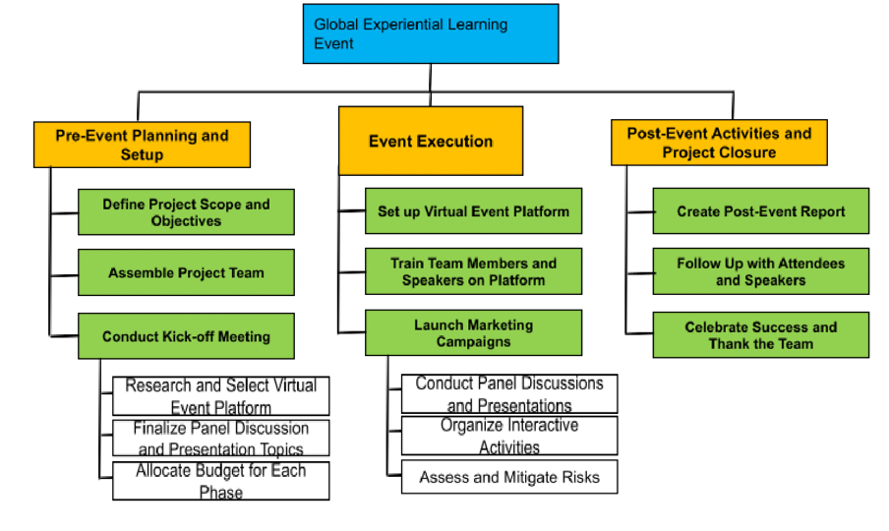
Work Breakdown Structure

Slide 13
Project Budget
& GANTT Chart

Slide 14
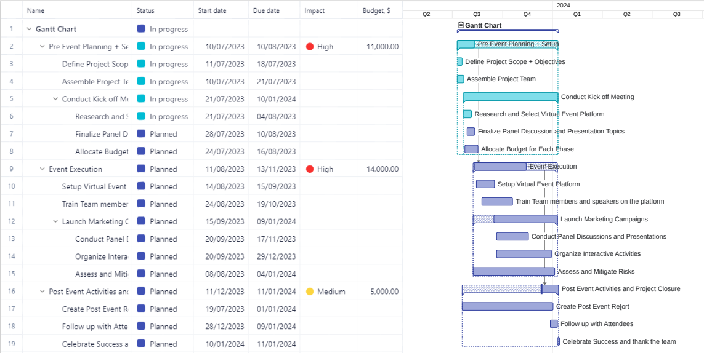

Slide 15
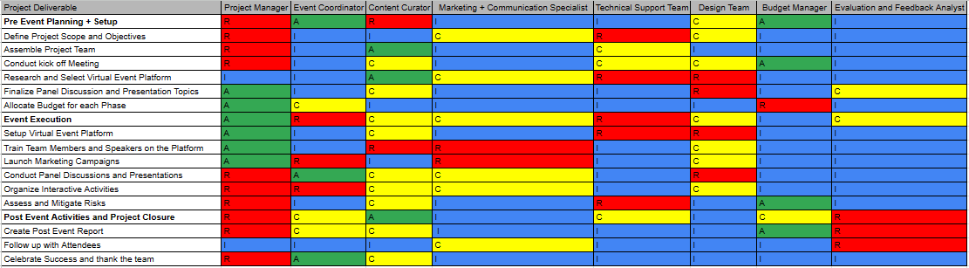
RACI Matrix

Slide 16
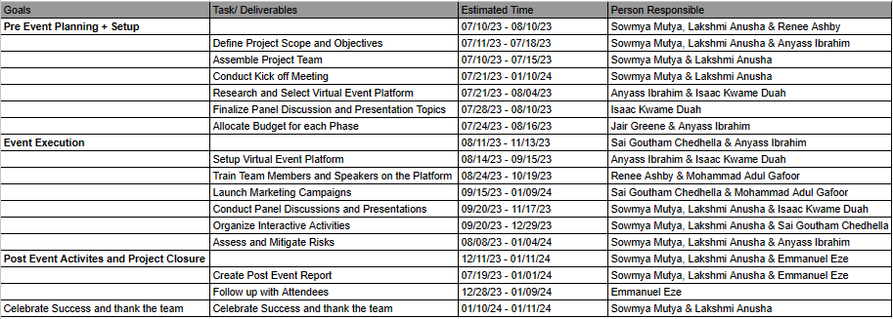
Person Goals with Persons Responsible

Slide 17
Project Risks
& Mitigations

Slide 18
WBS ID | ITEM / TASK DESCRIPTION | GATHERED BY | BEST-CASE | MOST LIKELY / REALISTIC | WORST-CASE | WEIGHTED AVERAGE
1.1 | Pre Event Planning Setup | Sowmya Mutya, Lakshmi Anusha & Renee Ashby | $9000.00 | $11,000.00 | $14,000.00 | $11,166.67
1.1.1 | define Project Scope and Objectives | Sowmya Mutya, Lakshmi Anusha & Anyass Ibrahim | $500.00 | $800.00 | $1,200.00 | $816.67
1.1.2 | Assemble Project Team | Sowmya Mutya & Lakshmi Anusha | $1000.00 | $1500.00 | $1,800.00 | $1,466.67
1.1.3 | Conduct Kick-off Meeting | Sowmya Mutya & Lakshmi Anusha | $300.00 | $500.00 | $1,000.00 | $550.00

Slide 19
WBS ID | ITEM / TASK DESCRIPTION | GATHERED BY | BEST-CASE | MOST LIKELY / REALISTIC | WORST-CASE | WEIGHTED AVERAGE
1.1.3.1 | Research and Select Virtual Event Platform | Anyass Ibrahim & Isaac Kwame Duah | $3,200.00 | $4,000.00 | $5,000.00 | $4,033.33
1.1.3.2 | Finalize Panel Discussion and Presentation Topics | Isaac Kwame Duah | $800.00 | $1,000.00 | $1,500.00 | $1050.00
1.1.3.3 | Allocate Budget for Each Phase | Jair Greene & Anyass Ibrahim | $3,000.00 | $3,200.00 | $3,500.00 | $3,216.67

Slide 20
WBS ID | ITEM / TASK DESCRIPTION | GATHERED BY | BEST-CASE | MOST LIKELY / REALISTIC | WORST-CASE | WEIGHTED AVERAGE
1.2 | Event Execution | Sai Goutham Chedhella & Anyass Ibrahim | $ 11,000.00 | $ 14,000.00 | $ 16,000.00 | $ 13,833.33
1.2.2 | Set up Virtual Event Platform | Anyass Ibrahim & Isaac Kwame Duah | $ 400.00 | $ 500.00 | $ 700.00 | $ 516.67
1.2.3 | Train Team Members and Speakers on Platform | Renee Ashby & Mohammad Abdul Gafoor | $ 4,000.00 | $ 5,500.00 | $ 5,800.00 | $ 5,300.00
1.2.3.1 | Launch Meeting Campaigns | Sai Gotham Chedhella & Mohammad Abdul Gafoor | $ 1,500.00 | $ 2,000.00 | $ 2,800.00 | $ 2,050.00

Slide 21
WBS ID | ITEM / TASK DESCRIPTION | GATHERED BY | BEST-CASE | MOST LIKELY / REALISTIC | WORST-CASE | WEIGHTED AVERAGE
1.2.3.1 | Conduct Panel Discussions and Presentations | Sowmya Mutya, Lakshmi Anusha & Isaac Kwame Duah | $ 1,000.00 | $ 1,200.00 | $ 1,500.00 | $ 1,216.67
1.2.3.2 | Organize Interactive Activities | Sowmya Mutya, Lakshmi Anusha & Sai Goutham Chedhella | $ 1,500.00 | $ 1,800.00 | $ 2,000.00 | $ 1,783.33
1.2.3.3 | Assess and Mitigate Risk | Sowmya Mutya, Lakshmi Anusha & Anyass Ibrahim | $ 2,600.00 | $ 3,000.00 | $ 3,200.00 | $ 2,966.67

Slide 22
WBS ID | ITEM / TASK DESCRIPTION | GATHERED BY | BEST-CASE | MOST LIKELY / REALISTIC | WORST-CASE | WEIGHTED AVERAGE
1..3 | Post Event Activities and Project Closure | Sowmya Mutya, Lakshmi Anusha & Emmanuel Eze | $ 4,000.00 | $5,000.00 | $6,000.00 | $ 5,000.00
1.3.1 | Create Post Event Report | Sowmya Mutya, Lakshmi Anusha & Emmanuel Eze | $ 1,800.00 | $ 2,000.00 | $ 2,200.00 | $ 2,000.00
1.3.2 | Follow up with Attendees | Emmanuel Eze | $ 700.00 | $ 1,000.00 | $ 1,300.00 | $ 1,000.00
1.3.3 | Celebrate Success and thank the team | Sowmya Mutya, Lakshmi Anusha | $1,500.00 | $2,000.00 | $2,500.00 | $ 2, 000.00
Total |  |  | $24,000.00 | $30,000.00 | $ 36,000.00 | $ 30,000.00

Slide 23
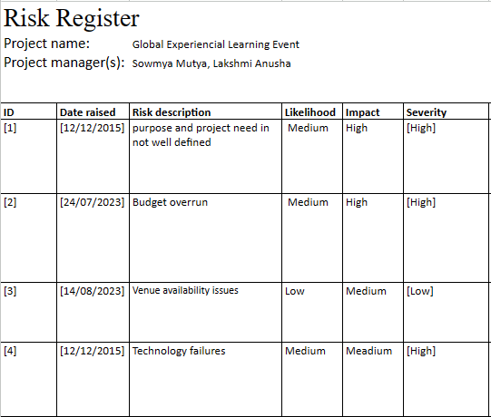

Slide 24
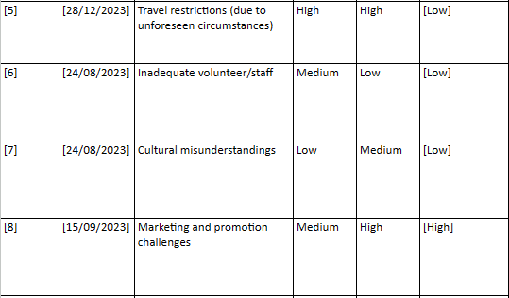

Slide 25
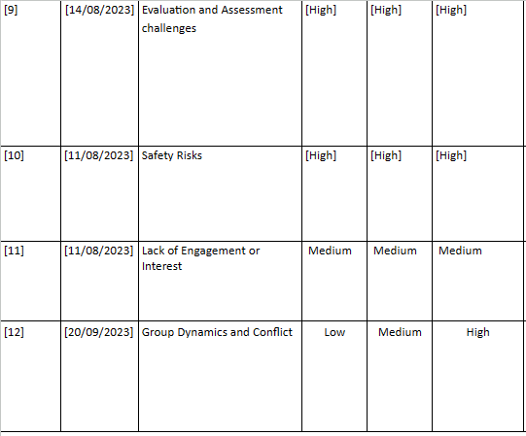

Slide 26
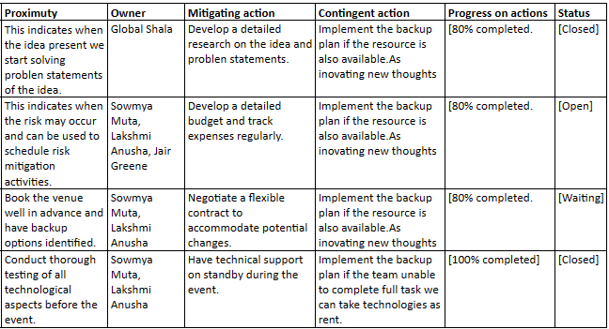

Slide 27
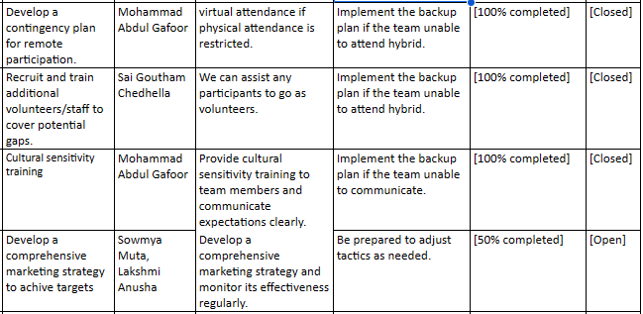

Slide 28
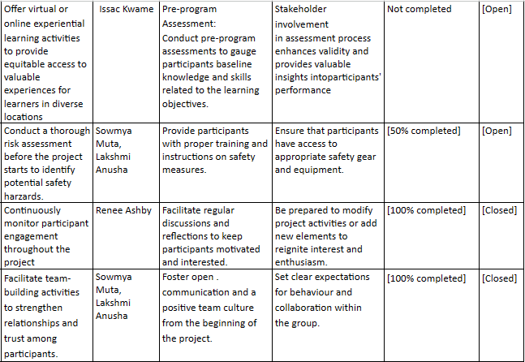

Slide 29
Conclusion
In conclusion, the successful execution of this project management task for the global learning event stands as a testament to our meticulous planning, dedication, and collaborative efforts. Through clear communication, strategic decision-making, and efficient resource allocation, we have achieved our objectives within the designated timeline and budget. As we reflect on the journey we've undertaken, we recognize the invaluable experience gained and the impact this event will have on learners worldwide.

Slide 30
Thanks for your Time…

